Slide 1

Analysis of Thermal Barrier Coating
for Gas Turbine Blade
Bharat Space Education Research Centre
Presented by: Sharon Philip
Reg no : BSERC -06519

Slide 2
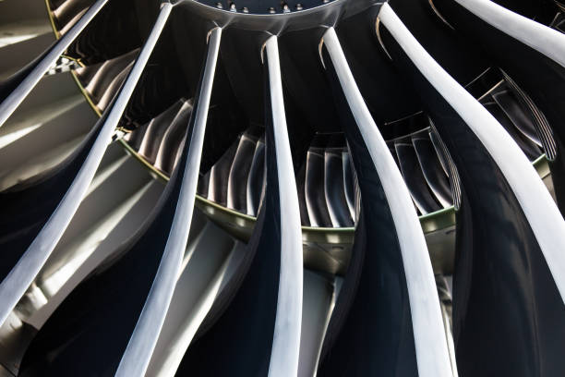
Introduction
A gas turbine blade is a key component in engines where hot gases strike the blade and cause it to rotate, generating power. Since it operates at extremely high temperatures, protecting it from heat is very important.
To protect the blade material from excessive heat, Thermal Barrier Coatings (TBC) are used. In this project, Yttria-Stabilized Zirconia (YSZ) coating is applied on an Inconel 713 gas turbine blade to improve thermal resistance and reduce heat transfer.
A study using ANSYS to evaluate how YSZ ceramic coatings reduce heat transfer and improve durability in high-temperature turbine environments.

Slide 3
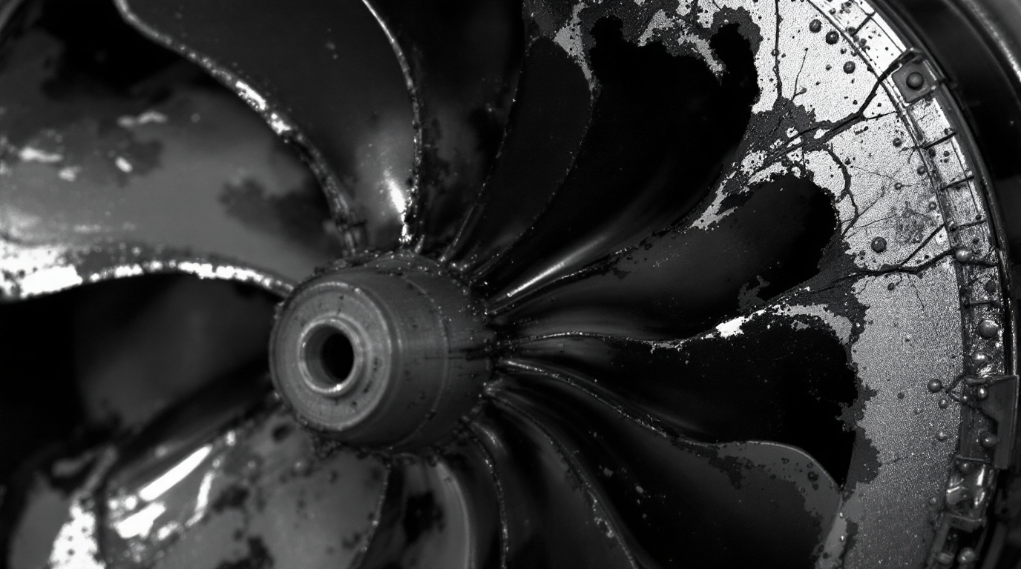
Problem Statement
Gas turbine blades operate at very high temperatures. In this High temperature leads to material degradation and failure. So Thermal protection is essential for performance and safety.
Thermal Barrier Coatings (TBC) are used to reduce heat transfer and YSZ (Yttria-Stabilized Zonia) is a widely used TBC material.

Slide 4
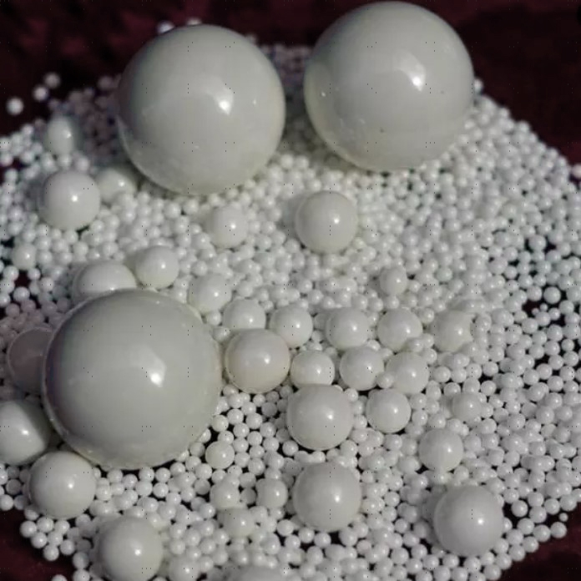
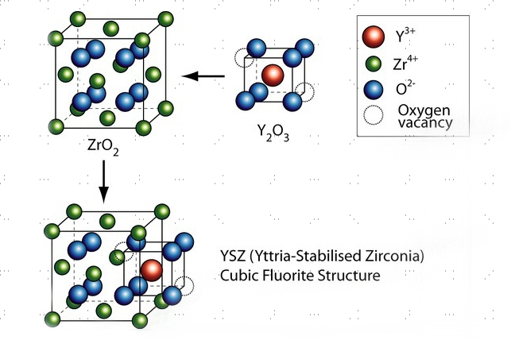
Material
Material using as coating at the top of Inconel 713
YSZ (Yttria stabilized zirconia)
Low thermal conductivity
Reduces heat transfer
Reduces deformation of blade
Prevents cracking and failure
High resistance to oxidation and corrosion
Improves turbine blade life
Best performance among YSZ, Al₂O₃, and LHA

Slide 5
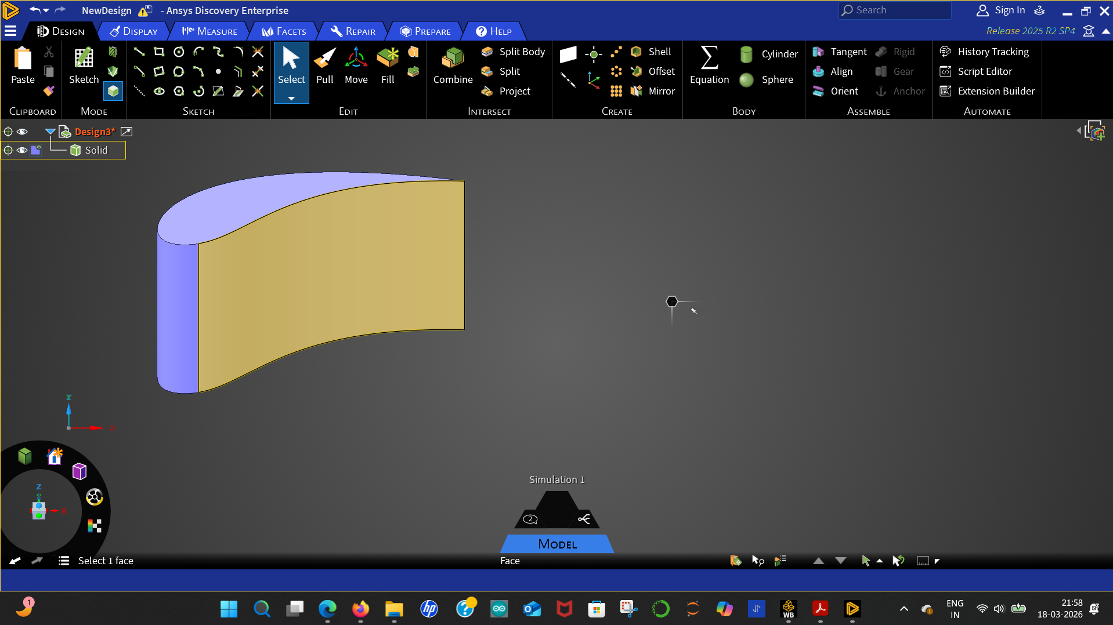
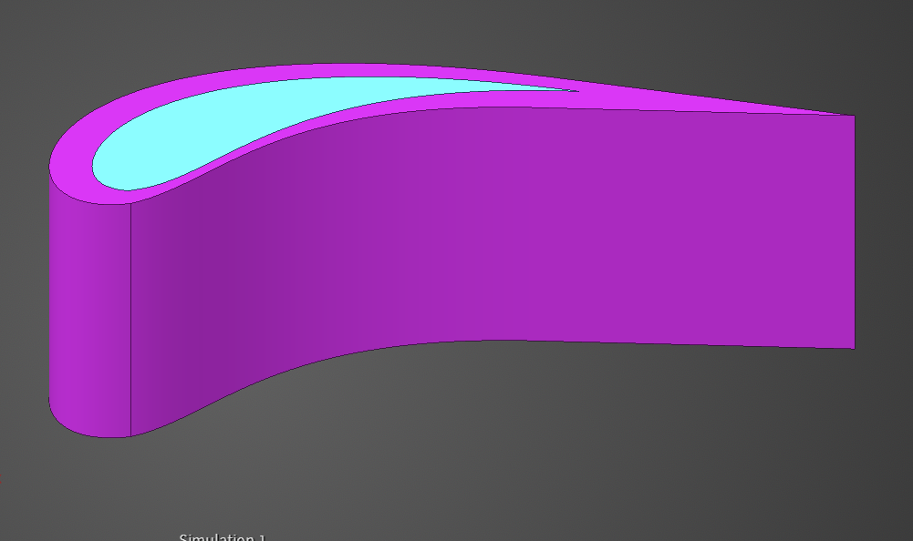
CAD MODEL
WITHOUT COATING
WITH COATING
Blade dimensions:
Chord: 39.2 mm
Height: 33 mm
Blade dimensions:
Chord: 39.2 mm
Height: 33 mm
With coating (1.8 mm) Thickness

Slide 6
Steps Completed..
Mesh analysis
The CAD model is divided into small elements (mesh)
Mesh helps in accurate numerical analysis
Thermal analysis
Used to find temperature distribution in blade.
Structural Analysis
Ensures real-world loads, stresses, and thermal effects without failure, while optimizing safety, performance, and material usage

Slide 7
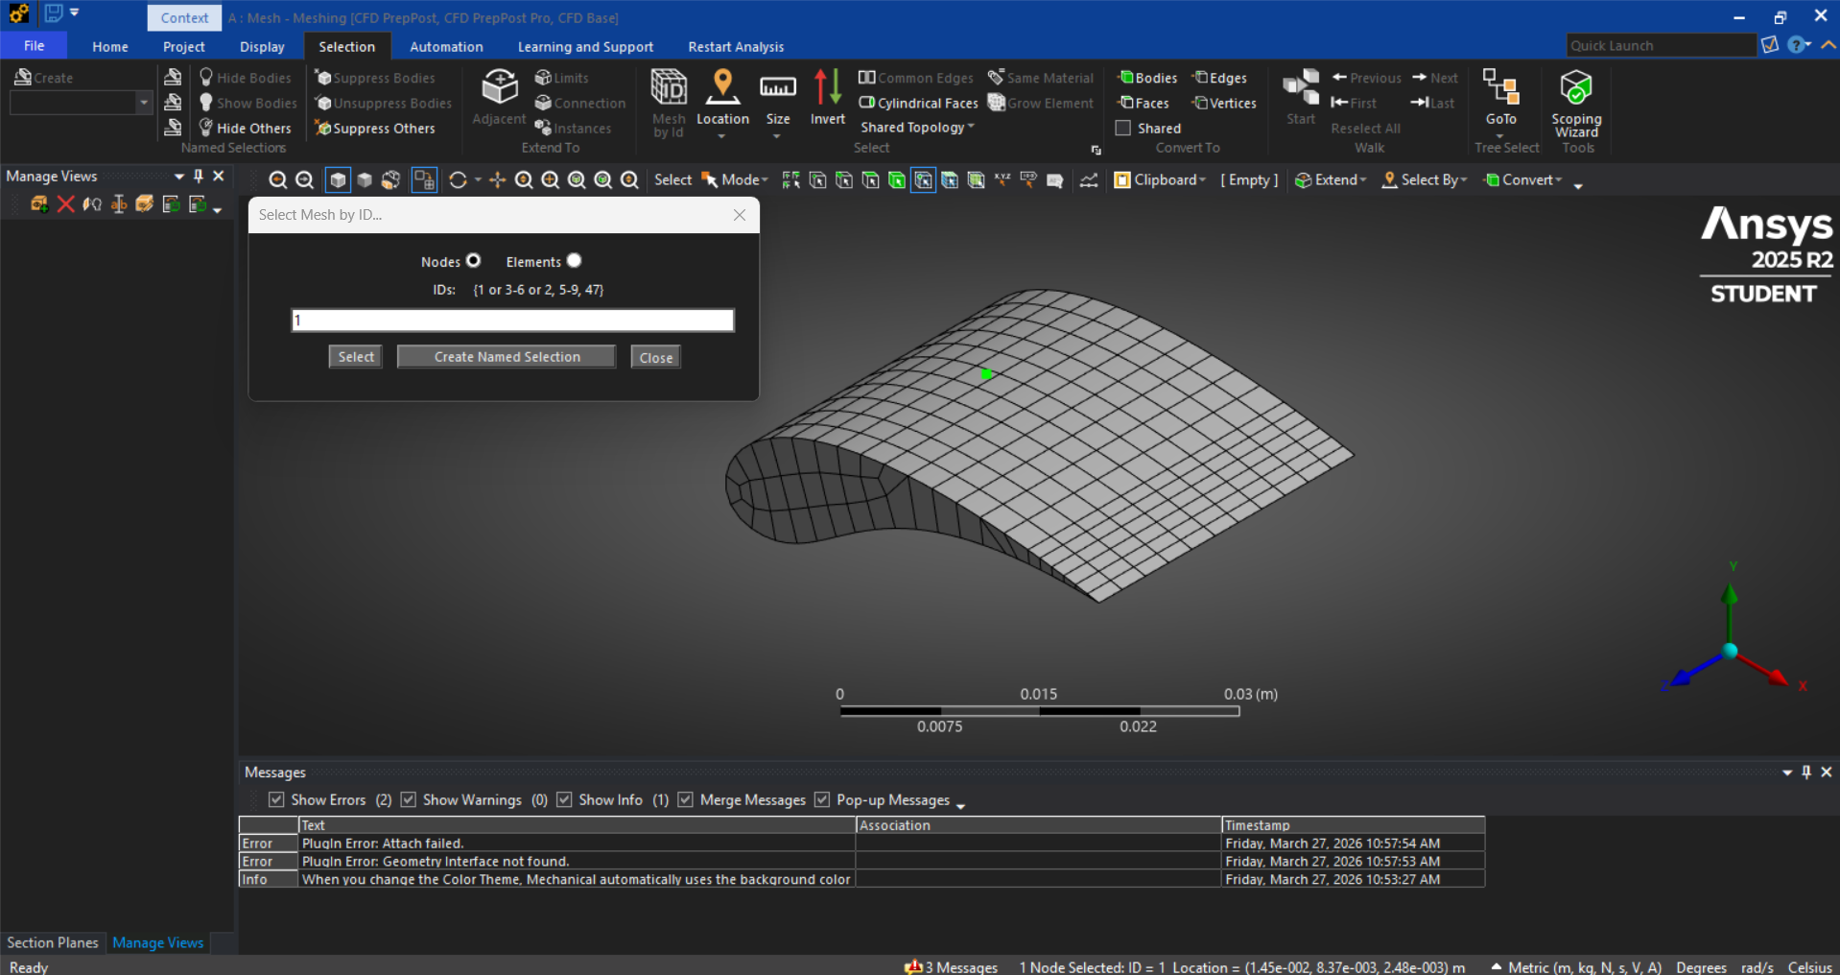
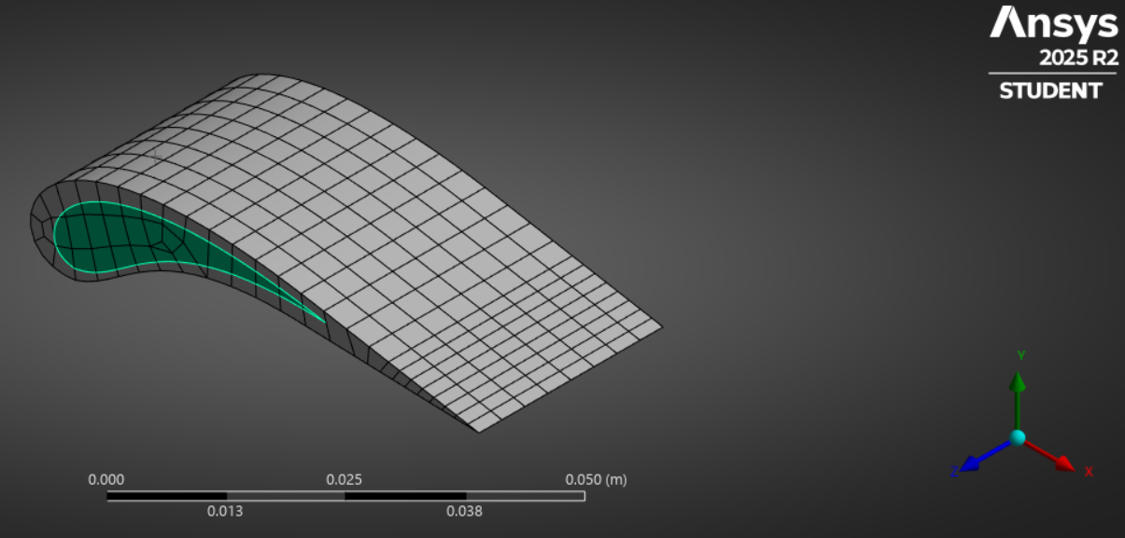
Mesh Analysis
Without Coating
With coating
Uniform mesh applied on blade geometry
Moderate element size used for faster computation
Nodes : 2555
Elements : 429
Finer mesh near coating region
Captures interface behavior between coating and substrate
Nodes : 2146
Elements : 344

Slide 8
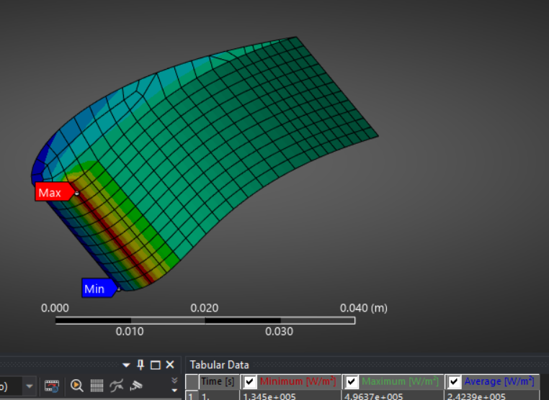
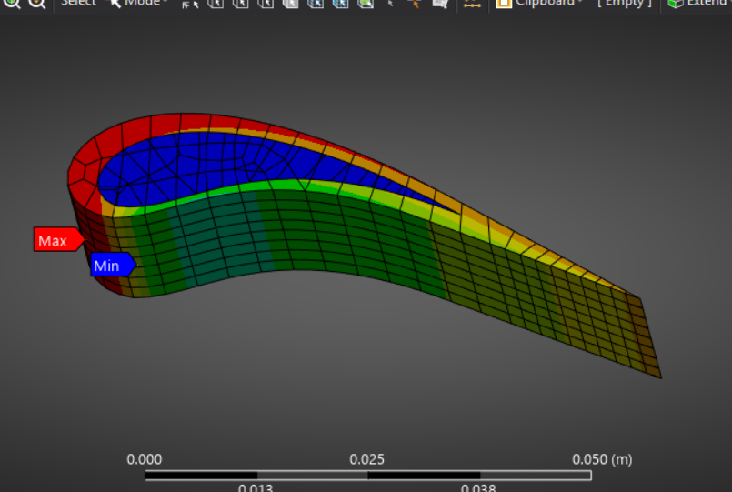
Thermal Analysis
Without coating
With coating
Temperature observed on blade surface
Heat penetrates directly into base material
Reduced temperature inside blade
Coating acts as thermal barrier
Thermal barrier coating improves heat resistance and protects substrate

Slide 9
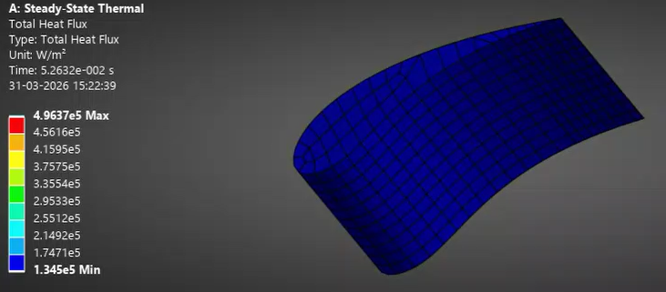
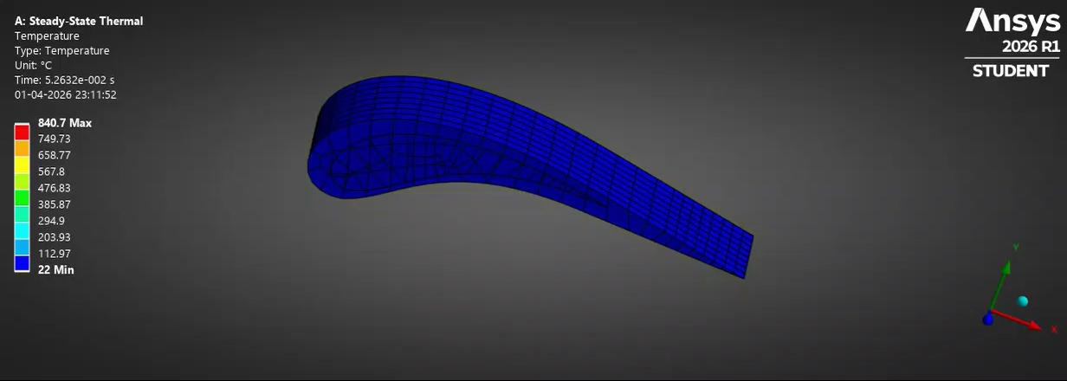
Thermal Analysis (Visual Representation)
Without Coating
With Coating

Slide 10
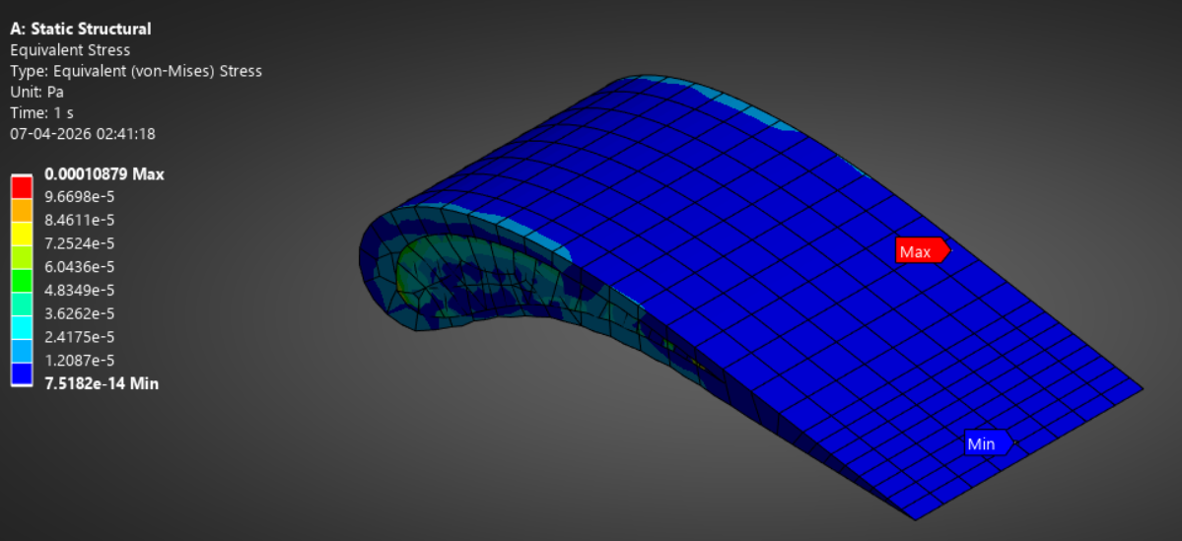
Structural Analysis
Higher stress concentration observed near curved/leading edge region
Lower stress towards flat and tip regions.
• Results:
Maximum stress: 1.0879 × 10⁻⁴ Pa (located near mid-region)
Minimum stress: 7.5182×10−14Pa (towards blade tip)
The coating helps the turbine blade handle high temperature with lower stress and better durability.

Slide 11
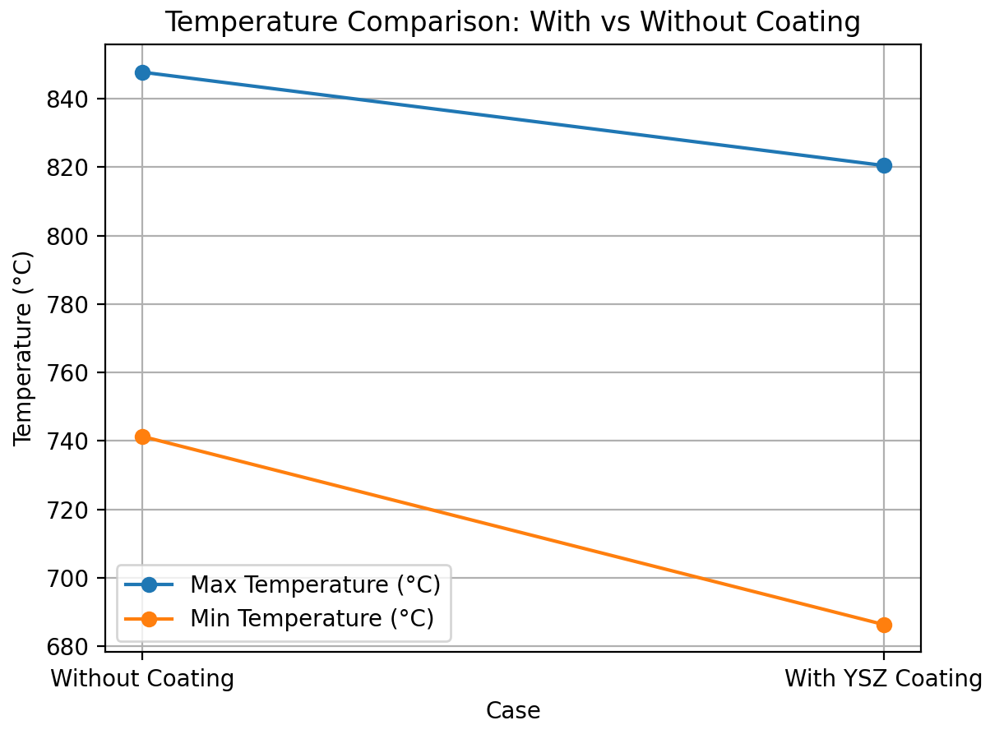

Slide 12
Results comparison
Parameter | Without Coating | With Coating
Temperature | Higher | Lower
Heat Penetration | Direct into blade | Reduced
Thermal Protection | Poor | Excellent
Structural Safety | Moderate | Improved
The YSZ coating acts as a thermal barrier, reducing heat transfer into the blade and improving thermal protection and structural stability

Slide 13
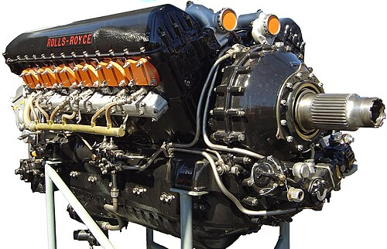
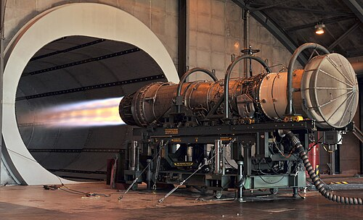
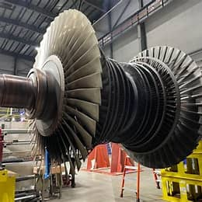
Future work
Compare different coating materials such as:
YSZ
Alumina
Zirconia-based composites
Apply the coating concept to:
Aircraft engines
Jet turbines
Power plant turbines
Aircraft engine
Jet turbine engine
Power plant turbines

Slide 14
CONCLUSION
The comparison of Inconel-713 (without coating) and coating of different material such as YSZ
(Yattria Stabilized Zirconia as shown in the above. From the above comparison, it is found that YSZ coating has minimum deformation and minimum Von-misses stress.
Compared to the uncoated blade, the coated blade shows:
Lower temperature effect on the blade body
Better thermal protection
Reduced heat transfer
Improved structural safety
Increased blade durability
YSZ coating is suitable for high-temperature aerospace turbine applications.

Slide 15
References
R. Rajendran , M.D. Ganeshachar, Jivankumar, T. Mohana Rao,(2011),Condition assessment of gas turbine blades and coatings.
Józef Błachnio and Wojciech Izydor Pawlak (2011). Damageability of Gas Turbine Blades – Evaluation of Exhaust Gas Temperature in Front of the Turbine Using a Non-Linear Observer, Advances in Gas Turbine Technology.
David R. Clarke, Matthias Oechsner , and Nitin P. Padture ,Guest Editors,(2012),Thermal- barrier coatings for more efficient gas-turbine engines.
N. Asok Kumar, S.R. Kale,(2002), Numerical simulation of steady state heat transfer in a ceramic-coated gas turbine blade.

Slide 16
Thank you

